Slide 1
Time-table management system for educational institutions

Slide 2
REQUIREMENTS
Languages: PYTHON , SQL
Framework : PYTHON based windows GUI
System Requirements : Python3.0 windows

Slide 3
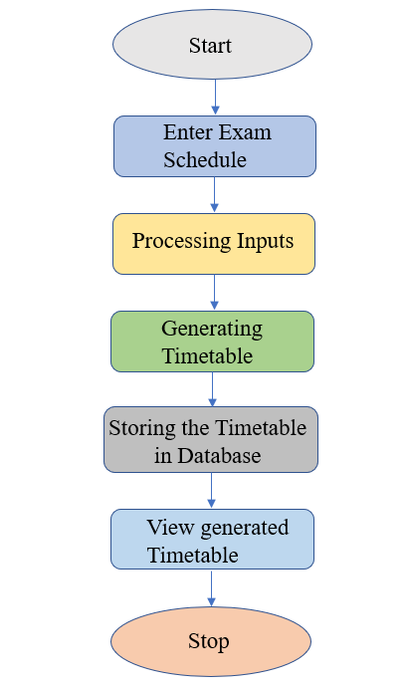
FLOWCHART

Slide 4
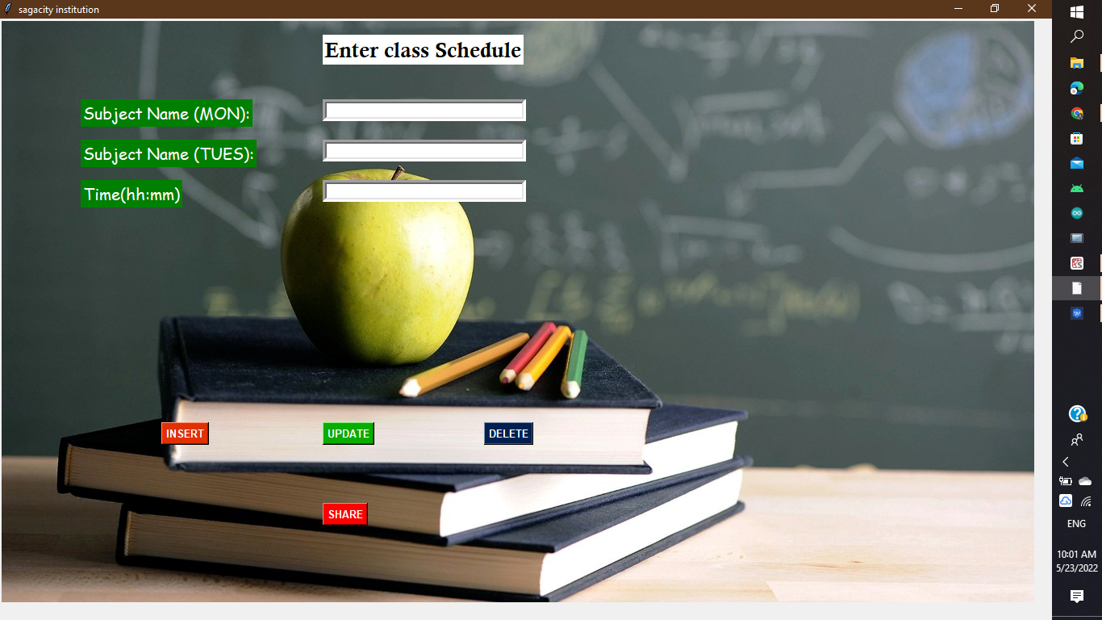
Figure1- front end window that appears after running the python code

Slide 5

FIGURE2- ENTERING DATA

Slide 6
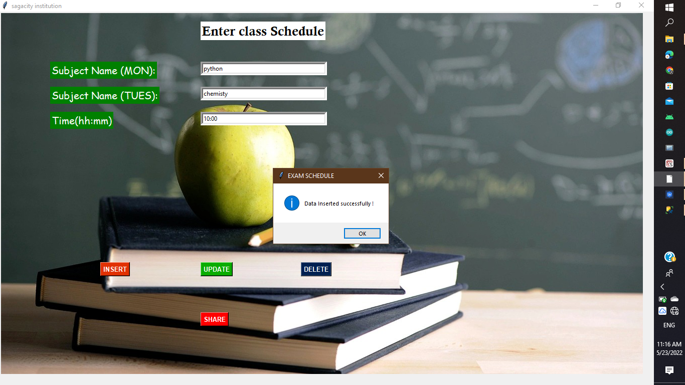
Figure3- data inserted successfully. A pop-up message will display the status

Slide 7
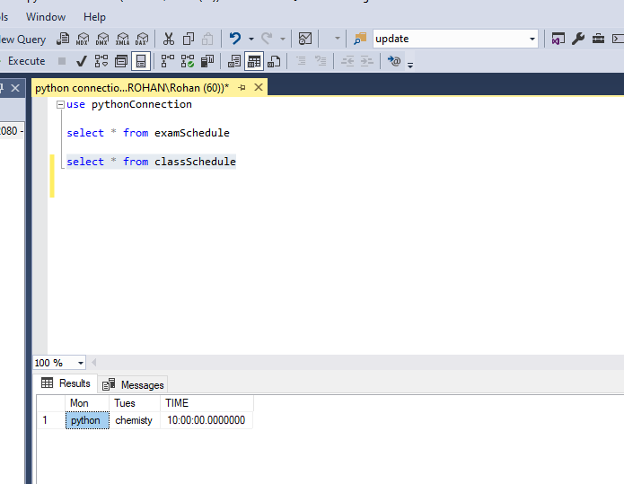
Figure4- data insertion successful

Slide 8
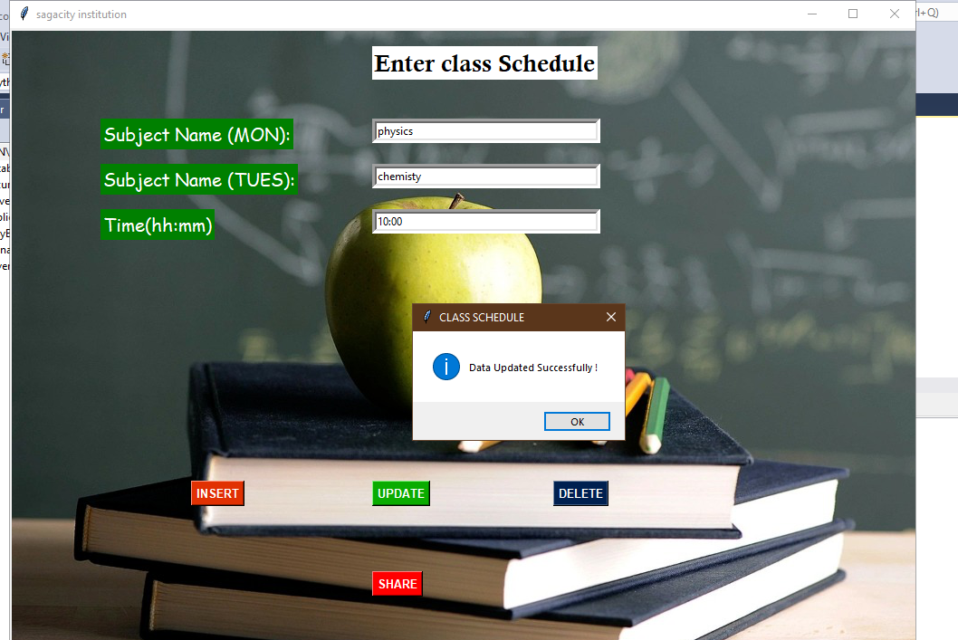
Figure5- updating Subjects (time is kept constant)

Slide 9
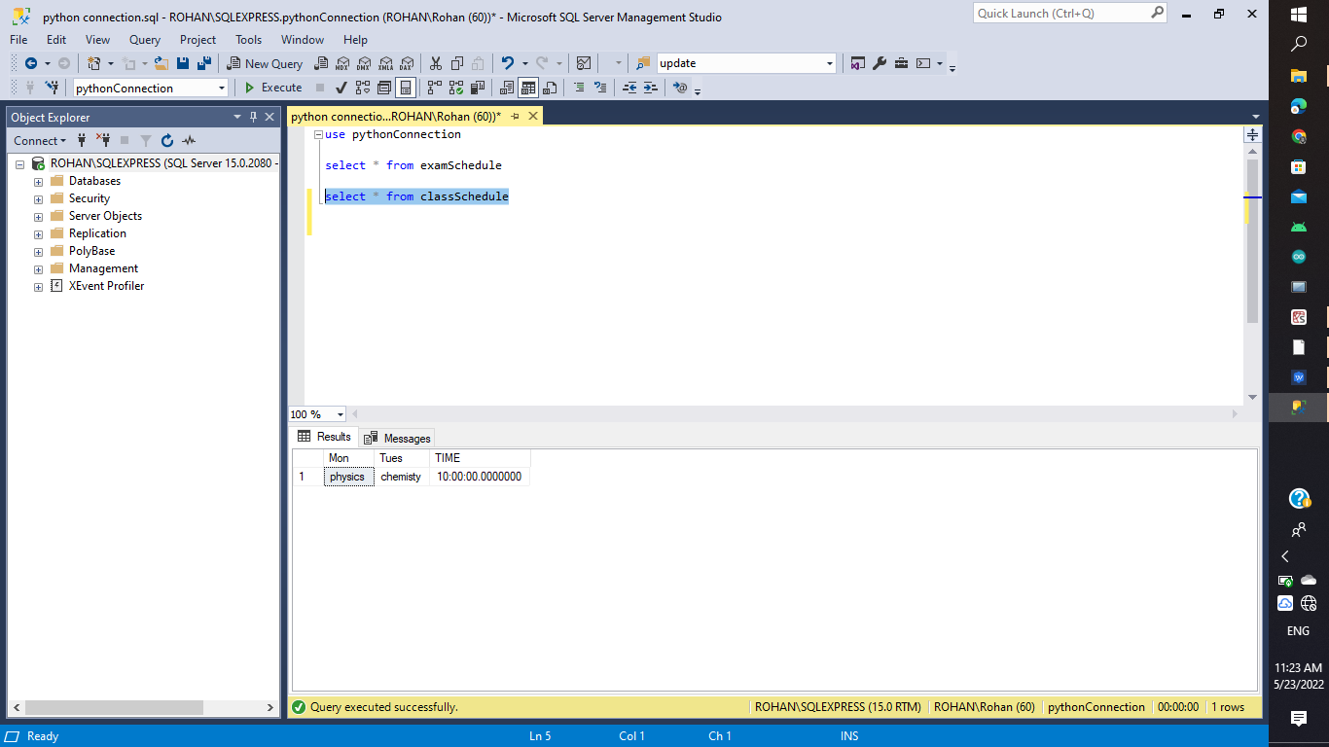
Updated Database

Slide 10
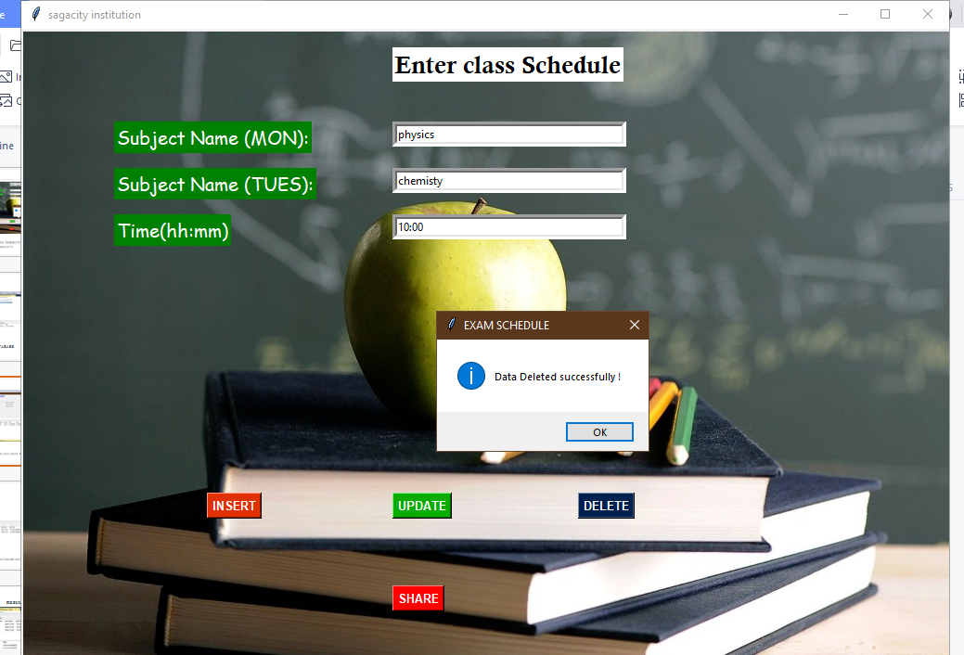
Figure6- deleting data from the storage

Slide 11
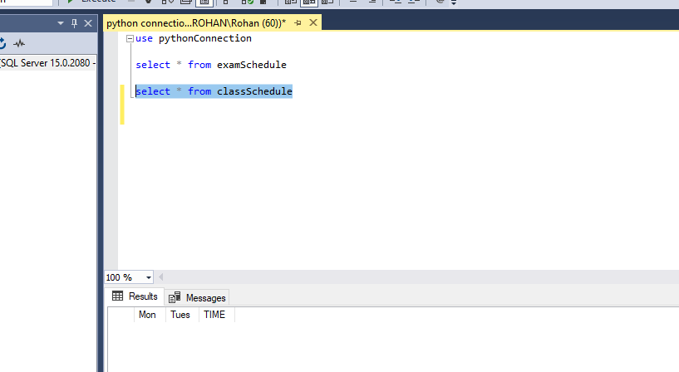
Figure7- final database output after deleting

Slide 12
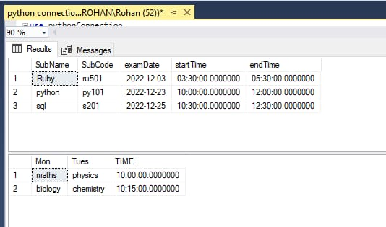
RESULT
Figure 8:- Final database output with other tables

Slide 13
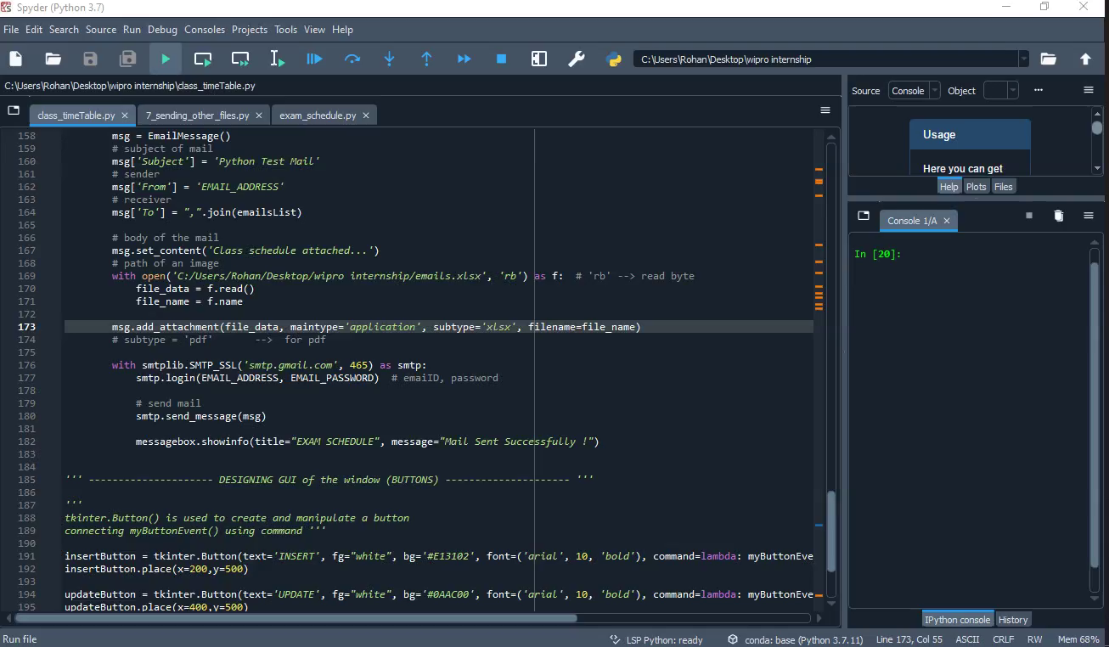
VIDEO REPRESENTATION OF OUR WORK

Slide 14
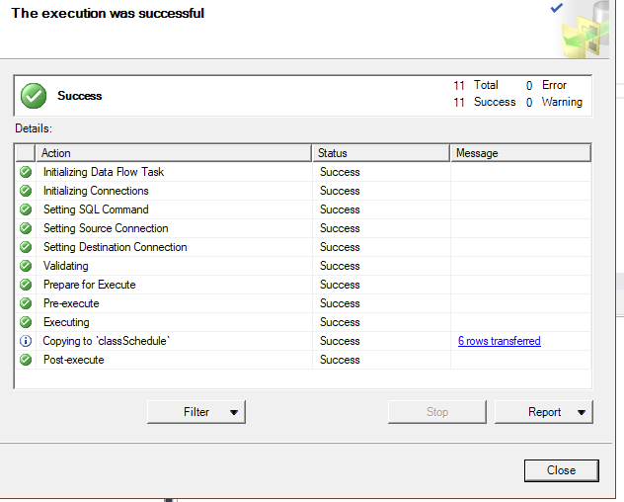
Exporting database table to excel file

Slide 15
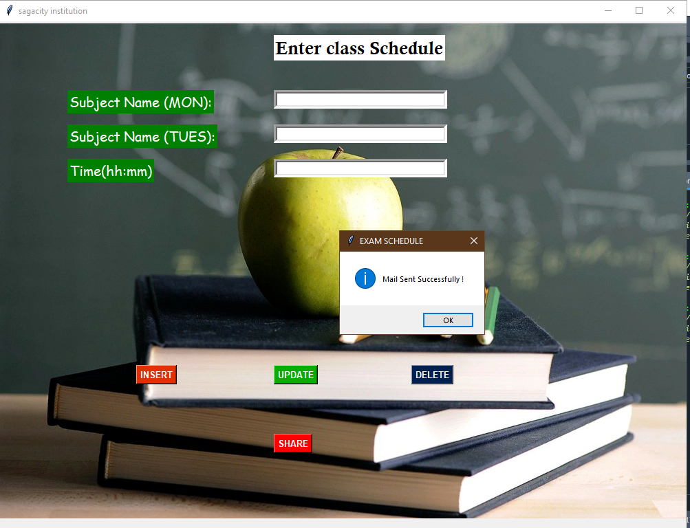
Sending the Excel file of the table to the recipients. Recipient email ids are fetched from a separate excel file

Slide 16
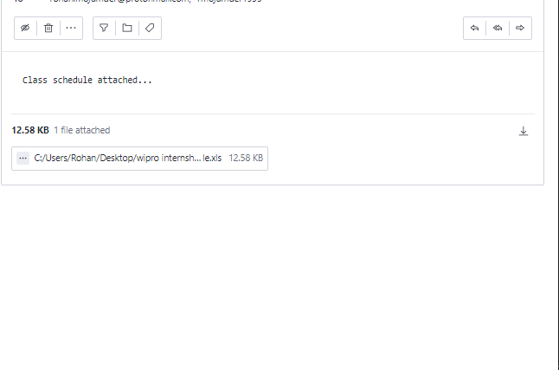
EMAIL RECEIVED BY MULTIPLE RECIPIENTS AT ONCE

Slide 17
THANK YOU.....!!!!!!

